Slide 1
Interprocess Communication

Slide 2
Types of Process
Independent Process
  If it cannot affect or be affected by the other processes executing in the system
  It doest not share data with any other process
Cooperating Process
  If it can affect or be affected by the other processes executing in the system
  It shares data with the other processes in the system

Slide 3
Cooperating Process
Reasons for process cooperation:
  Information sharing
  Computation speed
  Modularity
  Convenience

Slide 4
Mechanisms
There are two mechanisms/models by which cooperating processes can share data and information:
  Shared Memory
  Message passing

Slide 5
Shared Memory
A region is established that will be shared by the cooperating processes
Processes can then share/exchange data and information by reading and writing into that shared region
In most modern OS, processes that are
working together often share some common storage
– Shared memory
– Shared file system

Slide 6
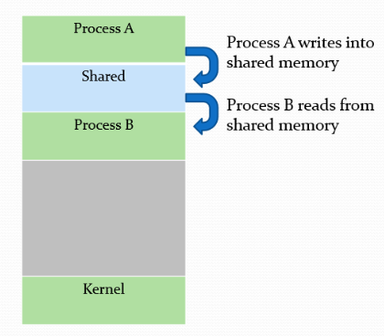
Shared Memory

Slide 7
Shared memory example
shmget()-A process creates a shared memory segment
shmctl()-The original owner of a shared memory segment can assign ownership to another user
shmat()-Once created, a shared segment can be attached to a process address space using shmat().
shmdt()-to detached a share memory

Slide 8
Shared memory
Shared memory model is useful in exchanging large amounts of data.
If two or more processes are writing to the same location simultaneously then a problem arises- RACE CONDITION
The processes must be synchronized in order to avoid such problems
Producer-consumer problem.

Slide 9
Message Passing
Memory is not shared among processes
Processes communicate through message passing.
This type of model is particularly used in distributed environments where the communicating processes may reside on different computers connected by a network.
Example: chat program used on www.

Slide 10
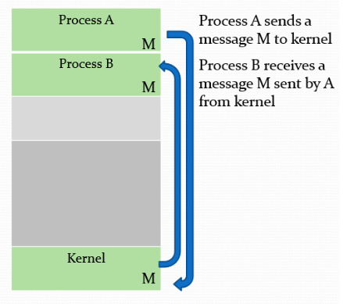
Message Passing

Slide 11
Message Passing
There are two operations used in message passing:
  Send(message)
  Receive(message)
Messages can be of fixed size or variable size.
For two processes to communicate with each other there must be a communication link established between them.

Slide 12
Message Passing
Direct or indirect communication
Synchronous or asynchronous communication
Automatic and explicit buffering

Slide 13
Direct Communication
Name the sender and receiver(symmetry)
  send(P, message)
  receive(Q ,message)
  Only two processes can communicate
Name the receiver only(asymmetry)
  Send(P, message)
  Receive(id , message)
  More than two processes can communicate with each other

Slide 14
Indirect Communication
With indirect communication the messages are sent to and received from the mailboxes, or ports
A mailbox can be viewed abstractly as an object into which messages can be placed by the processes and from which messages can be removed. Each mail box has a unique identification number
Example: POSIX message queues.

Slide 15
Indirect Communication
send(A, message)
receive(A, message)
Process those want to communicate must have a shared mail box
In this case a link may be associated with more than two processes
A mailbox may be either owned by a process or by the operating system.

Slide 16
Synchronous/ asynchronous
Message passing may be either blocking or nonblocking– also known as synchronous and asynchronous
  Blocking send- the sender process is blocked until the message is received by the receiving process or by the mailbox.
  Nonblocking send- the sending process sends the message and resumes operation.
  Blocking receive- the receiver blocks until the message is available
  Nonblocking receive- the receiver retrieves either a valid message or null

Slide 17
Explicit and automatic buffering
Zero-Capacity buffering-The queue has a maximum length of zero; thus, the link cannot have any messages waiting in it. In this case, the sender must block until the recipient receives the message.
Bounded buffering-The queue has finite length.
Unbounded buffering-the queue is of indefinite length.

